Slide 1
MACHINE LEARNING · REGRESSION
Multiple Linear
Regression
From a single best-fit line to a best-fit hyperplane — plus model quality, multicollinearity, and categorical predictors.
y = β₀ + β₁x₁ + β₂x₂ + … + βₙxₙ
Classroom Lecture Deck · Full session: from fundamentals to multicollinearity

Slide 2
RECAP
Before We Start: Three Types of Linear Regression
Last class we defined linear regression and looked closely at the simplest case. Here's where multiple regression fits in.
▲ TODAY
1
2
3
Simple Linear
Regression
Multiple Linear
Regression
Polynomial
Regression
One input column, one output column. Fit a straight best-fit line.
Two or more input columns, one output column. Today's topic.
Curved (non-linear) relationship between inputs and output.
y = mx + b
y = β₀+β₁x₁+β₂x₂
y = β₀+β₁x+β₂x²
Multiple Linear Regression
2

Slide 3
RECAP
Simple Linear Regression, in One Picture
One input, one output
e.g. CGPA → Package (LPA). Plot the data as points on an X-Y graph.
Draw the best-fit line
The line that passes as close as possible to every point is the regression line.
Find its equation
Every straight line can be written as y = mx + b, where m is the slope and b is the intercept.
Package
Best-fit line
y = mx + b
CGPA →
Multiple Linear Regression
3

Slide 4
NEW CONCEPT
What Is Multiple Linear Regression?
Multiple Linear Regression (MLR) is simply an extension of simple linear regression: it's used when your dataset has more than one input (independent) column predicting a single output (dependent) column.
Worked Example
KEY IDEA
CGPA (x₁)
IQ (x₂)
Gender (x₃)
Package (y)
If your real-world dataset has one output but several input columns — which is the most common case — you must use Multiple Linear Regression, not Simple Linear Regression.
8.1
112
M
7.2 LPA
7.4
98
F
5.6 LPA
9.0
121
F
9.8 LPA
6.8
105
M
4.9 LPA
Why learn simple regression first, then?
Because everything you learned there — best-fit line, slope, intercept, error — generalizes directly into multiple regression.
3 input columns (independent variables) + 1 output column (dependent variable)
Multiple Linear Regression
4

Slide 5
VISUALIZING
Two Inputs? Now You Need a 3D Plot
With one input (CGPA) and one output (Package), a 2D scatter plot worked. Add a second input (IQ), and you now have three axes to plot at once — CGPA, IQ, and Package.
Package (y)
•
x-axis = CGPA (x₁)
•
y-axis = IQ (x₂)
•
z-axis = Package (y) — the output
Beyond 3 inputs, we can no longer draw the data at all — but the same mathematical idea still applies, we just can't see it.
CGPA (x₁)
IQ (x₂)
Each point = one student (CGPA, IQ, Package)
Multiple Linear Regression
5

Slide 6
CORE CONCEPT
A Line Becomes a Plane Becomes a Hyperplane
In simple regression we drew a best-fit LINE. In 3D (two inputs), the equivalent best-fit surface is a PLANE. Beyond 3 dimensions, that generalized surface is called a HYPERPLANE.
─
▱
∴
1 Input
2 Inputs
3+ Inputs
Best-fit LINE
Best-fit PLANE
Best-fit HYPERPLANE
2D space — x and y axes.
3D space — x₁, x₂ and y axes.
n-D space — cannot be drawn, but the math still works.
The goal is always the same: draw the surface that passes as close as possible to every data point — minimizing the total distance (error).
Multiple Linear Regression
6

Slide 7
THE MATH
Deriving the Equation, Step by Step
Start with the simple regression line
y = mx + b
1
Rename for consistency (β notation)
y = β₁x₁ + β₀
2
Add a second input for a plane
y = β₀ + β₁x₁ + β₂x₂
3
Add a third input for 4D
y = β₀ + β₁x₁ + β₂x₂ + β₃x₃
4
Each additional input column simply adds one more “β×x” term to the equation.
Multiple Linear Regression
7

Slide 8
GENERALIZATION
The General Equation for n Input Columns
y = β₀ + β₁x₁ + β₂x₂ + β₃x₃ + … + βₙxₙ
Written as a matrix multiplication — for one row of data
What each symbol means
·
β₀
=
y
Output we predict
βᵢ
1
x₁
x₂
⋮
xₙ
y
x₁ … xₙ
The n input features
β₂
row of X (features, with a leading 1 for the bias)
⋮
β₀
Intercept (baseline)
Multiply each feature by its matching β, then add everything up — that sum is the predicted y for that row.
βₙ
β₁ … βₙ
Weight of each feature
column of β
coefficients
For n input columns, the model has exactly n + 1 unknowns to solve for: β₀, β₁, β₂, …, βₙ
Multiple Linear Regression
8

Slide 9
QUICK RULE
How Many Coefficients Do You Need to Find?
The rule is simple: count your input columns (n), then add one for the intercept.
Input Columns
Equation
Coefficients to Find
1
y = β₀ + β₁x₁
2
2
y = β₀ + β₁x₁ + β₂x₂
3
3
y = β₀ + β₁x₁ + β₂x₂ + β₃x₃
4
n
y = β₀ + β₁x₁ + … + βₙxₙ
n + 1
Example: a dataset with 5 input columns needs 6 coefficients — β₀ through β₅ — solved using linear regression.
Multiple Linear Regression
9

Slide 10
INTERPRETATION
What Do the Beta (β) Values Actually Tell Us?
Each coefficient βᵢ measures how strongly — and in what direction — its input feature influences the output, once the other features are accounted for.
β₂ very small / near 0
IQ barely affects Package — the output doesn't really depend on IQ.
β₁ very small / near 0
CGPA barely affects Package — the output doesn't really depend on CGPA.
β₁ large (e.g. > 20,000)
CGPA is a highly important driver of Package — small CGPA changes move the prediction a lot.
β₀ (intercept) alone
If every input were 0, this is the baseline value the model would still predict.
Multiple Linear Regression
10

Slide 11
APPLYING IT
Using the Model to Predict a New Package
Once β₀, β₁ and β₂ are known (found using linear regression), predicting for a brand-new student is just plugging numbers into the equation.
1
2
3
4
Trained Model
New Student's Data
Plug Into Equation
Predicted Package
β₀ = 1.5
β₁ = 0.9
β₂ = 0.04
CGPA (x₁) = 8.2
IQ (x₂) = 115
y = 1.5 + 0.9(8.2)
+ 0.04(115)
y ≈ 13.4 LPA
Multiple Linear Regression
11

Slide 12
CODE ALONG
Multiple Linear Regression in Python (scikit-learn)
As demonstrated live in the notebook: generate a multi-feature dataset, split it, fit the model, then read off the learned coefficients.
from sklearn.datasets import make_regression
from sklearn.model_selection import train_test_split
from sklearn.linear_model import LinearRegression
# 2 input columns, 1 output column
X, y = make_regression(n_samples=100, n_features=2, n_targets=1)
X_train, X_test, y_train, y_test = train_test_split(X, y, test_size=0.2)
model = LinearRegression()
model.fit(X_train, y_train)
print(model.coef_) # β₁, β₂ — the slope coefficients
print(model.intercept_) # β₀ — the intercept
make_regression()
Generates a synthetic dataset with a chosen number of input features — handy for testing any dimensionality.
train_test_split()
Splits data so the model is evaluated on unseen points, not the ones it trained on.
model.coef_ / .intercept_
After fitting, these attributes hold the learned β₁…βₙ and β₀ values directly.
Multiple Linear Regression
12

Slide 13
CHECKPOINT
What We've Covered So Far
1
Definition
2
Geometry
MLR predicts one output from two or more input columns — a direct extension of simple linear regression.
1 input → line, 2 inputs → plane, 3+ inputs → hyperplane (can't be drawn, but works the same way).
3
Equation
4
Unknowns
y = β₀ + β₁x₁ + β₂x₂ + … + βₙxₙ, or compactly y = X·β.
For n input columns, exactly n + 1 coefficients (β₀ … βₙ) need to be estimated.
5
Interpretation
6
In practice
A larger |βᵢ| means that feature has a bigger influence on the predicted output.
scikit-learn's LinearRegression().fit() finds all coefficients automatically from data.
Multiple Linear Regression
13

Slide 14
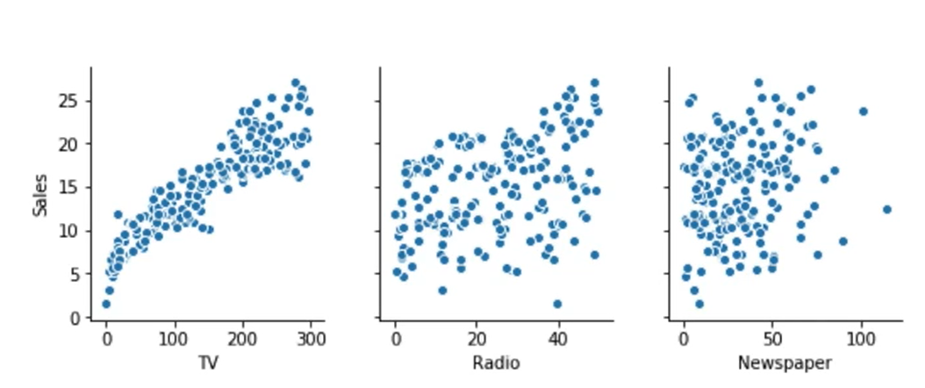
Consider an advertising dataset: TV, Radio, and Newspaper budgets, each tried as a lone predictor of Sales. Adding a second predictor can noticeably improve fit.

Slide 15
PART 2 · MOTIVATION
When Is One Variable Not Enough?
Model (Predictors)
R²
READING THE TABLE
TV alone
0.61
R² (“R-squared”) measures how much of the variation in Sales the model explains — closer to 1 is better.
Radio alone
0.33
Newspaper alone
0.05
TV alone explains 61% of the variance. Adding Radio pushes that to 90% — Radio carries information TV doesn't.
TV + Radio
0.90
TV + Newspaper
0.65
Newspaper barely helps on its own — a hint that some predictors add little, which matters later for feature selection.
Takeaway: combining predictors that carry different information almost always beats any single predictor alone.
Multiple Linear Regression
14

Slide 16
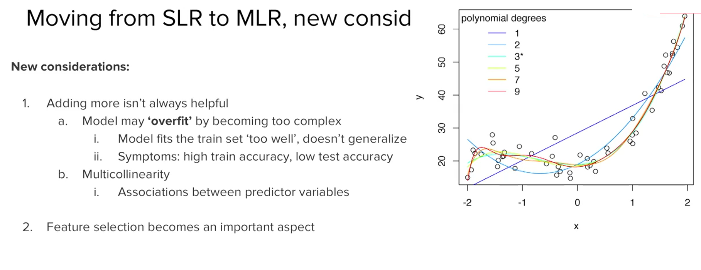

Slide 17
PART 2 · CAUTION
More Variables Isn't Always Better
Adding predictors always improves the training fit — but that doesn't mean the model actually generalizes to new data.
RISK
WARNING SIGN
FIX
Overfitting
Symptom
Feature Selection
As you keep adding variables, the model can become too complex. It may memorize the training data instead of learning the real pattern.
Training accuracy stays very high, but test (unseen-data) accuracy is noticeably lower — the model “fails to generalize.”
Rather than using every column available, select the subset of predictors that adds real explanatory power without redundancy.
Rule of thumb: a model is “general” when training and test accuracy stay close together, not just when training accuracy is high.
Multiple Linear Regression
15

Slide 18
PART 2 · NEW CONCEPT
What Is Multicollinearity?
Multicollinearity happens when two or more input columns are strongly correlated with each other — they carry overlapping information. Multicollinearity refers to the phenomenon of having related predictor variables in the input dataset. In simple terms, in a model which has been built using several independent variables, some of these variables might be interrelated, due to which the presence of that variable in the model is redundant. You drop some of these related independent variables as a way of dealing with multicollinearity
THOUGHT EXPERIMENT
Suppose predictors X₁ and X₂ are exactly the same column, duplicated. Does it matter whether the model is written as:
20x₁ + 0x₂
10x₁ + 10x₂
9x₁ + 11x₂
All four predict identically — infinitely many coefficient combinations fit equally well. That instability is multicollinearity's core problem.
Multiple Linear Regression
16

Slide 19
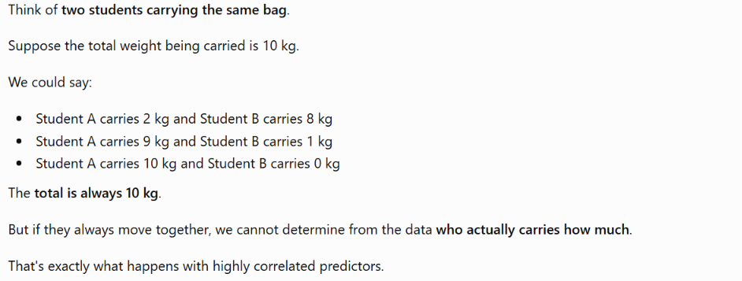
Multicollinearity affects | Why?
Individual coefficients | They become unstable
p-values / inference | Individual effects become difficult to establish
Interpretation | "Holding other variables constant" may be impossible or unrealistic
Coefficient signs | Can change, even from + to −
Usually not strongly affected | Why?
Overall predictions | Correlated variables collectively still contain predictive information
R2^2 | Measures overall fitted variation
Overall goodness of fit | Depends on fitted values, not how the coefficient contribution is divided

Slide 20
PART 2 · DETECTION
Detecting Multicollinearity: Correlations
The first, simplest check: look at how strongly each pair of predictors is correlated with each other — not just with the output.
Illustrative correlation matrix
1
Scatter plots — visually inspect each pair of predictors for a linear trend.
BP
Age
Weight
BSA
Pulse
BP
1.00
0.66
0.95
0.87
0.51
2
Correlation coefficients — quantify that trend with a number from –1 to +1.
Age
0.66
1.00
0.41
0.38
0.62
Weight
0.95
0.41
1.00
0.88
0.66
Limitation: pairwise correlation only catches two-way relationships. A predictor could be predictable from a combination of several others — that needs a different tool (next slide).
BSA
0.87
0.38
0.88
1.00
0.47
Pulse
0.51
0.62
0.66
0.47
1.00
Multiple Linear Regression
17

Slide 21
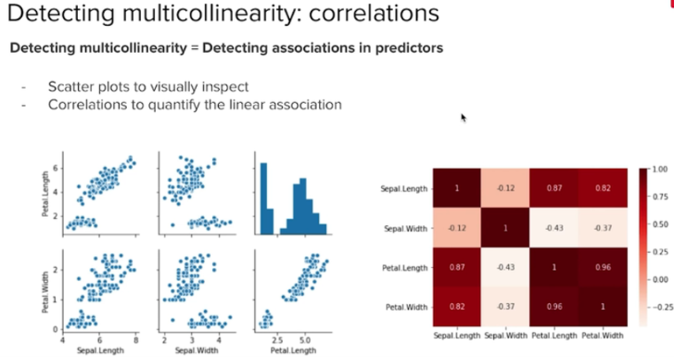

Slide 22
PART 2 · DETECTION
Detecting Multicollinearity: Variance Inflation Factor
Pairwise correlation isn't always enough — a predictor can be well-explained by a combination of several other predictors together.
IDEA: build a small regression that predicts one input column using all the other input columns as its predictors.
The Variance Inflation Factor for predictor i
Common heuristic
VIFᵢ = 1 / (1 − Rᵢ²)
VIF < 5
Generally fine
VIF 5–10
Worth a closer look
Rᵢ² = how well predictor i is explained by all the remaining predictors combined.
VIF > 10
Definitely high — investigate
Multiple Linear Regression
18

Slide 23
PART 2 · WORKED EXAMPLE
Calculating VIF: A Blood-Pressure Model
Predictors: Age, Weight, Body Surface Area (BSA), Duration of hypertension, Pulse, Stress — predicting Blood Pressure (BP).
Term
Coef
P-Value
VIF
VERIFYING VIF FOR WEIGHT
Constant
‒12.9
0.000
—
Regress Weight on the other five predictors (Age, BSA, Duration, Pulse, Stress):
Age
0.70
0.000
1.76
Weight
0.97
0.000
8.42
R² = 0.881 (88.1%)
BSA
3.78
0.182
5.33
Duration
0.068
0.126
1.24
VIF = 1 / (1 − 0.881)
= 1 / 0.119
≈ 8.42
Pulse
−0.08
0.126
4.41
Stress
0.006
0.341
1.83
Weight's VIF of 8.42 means its coefficient's variance is inflated 8.4× because Weight is highly correlated with at least one other predictor in the model.
Multiple Linear Regression
19

Slide 24
PART 2 · SOLUTIONS
Dealing With Multicollinearity
1
2
3
Drop Variables
Create New Variables
Transform Variables
Remove the predictor that is highly correlated with others, or pick the one that's more business-interpretable.
Combine correlated predictors into a single engineered feature, e.g. an interaction or ratio term.
Apply techniques like Principal Component Analysis (PCA) to convert correlated features into uncorrelated components.
e.g. drop Weight, keep BSA
e.g. BMI from Weight + Height
covered in a later module
Multiple Linear Regression
20

Slide 25
PART 2 · NEW CONCEPT
Handling Categorical Variables
Not every column is numeric. Categorical variables (like Gender or Relationship Status) can't be plugged into the equation directly — they need to become numbers first.
Two-level example: Gender
n-level rule: n − 1 dummy columns
Value
Dummy (Female)
For “Relationship Status” with 3 levels (Single, In a relationship, Married), you only need 2 dummy columns — the third is implied when both are 0.
Male
0
Female
1
Status
In a relationship
Married
y = β₀ + β₁x₁ + β₂·[Female]
Single
0
0
In a relationship
1
0
Married
0
1
Why n − 1, not n? If every dummy for a row is 0, that row must be the one remaining category — including all n would be redundant information.
Multiple Linear Regression
21

Slide 26
FULL SUMMARY
Putting It All Together
1
Core Model
2
Model Quality
y = β₀ + β₁x₁ + … + βₙxₙ — a hyperplane fit through n-dimensional data, with n+1 coefficients to solve for.
R² tells you how much variance is explained; watch for overfitting when adding more predictors.
3
Multicollinearity
4
Fixing It
Correlated predictors make coefficients unstable. Detect with correlation matrices and VIF; VIF > 5–10 is a red flag.
Drop redundant variables, engineer combined features, or use dimensionality reduction like PCA.
5
Categorical Data
6
Tooling
Convert categories into n−1 dummy/indicator variables before fitting the model.
scikit-learn's LinearRegression handles fitting; statsmodels or similar libraries report VIF and p-values.
Multiple Linear Regression
22

